Slide 1
The True Cost of Data Access
in ATLAS Experiment
Ilija Vukotic
University of Chicago
CHEP ‘2013
Amsterdam, Netherland

Slide 2
Balancing act
CPU
Disk space
Network
User experience
Versatility
Manpower

Slide 3
ATLAS computing infrastructure
CPU
Disk space
Network

Slide 4
Not all transfers are equal
Copy
Different clients
Direct
Describe all the main nuisances of ROOT file structure, TTC, read-ahead

Slide 5
Network measurements
PerfSONAR
FAX cost matrix
FTS

Slide 6
Checks
Sum ups
Correlations

Slide 7
conclusions

Slide 8
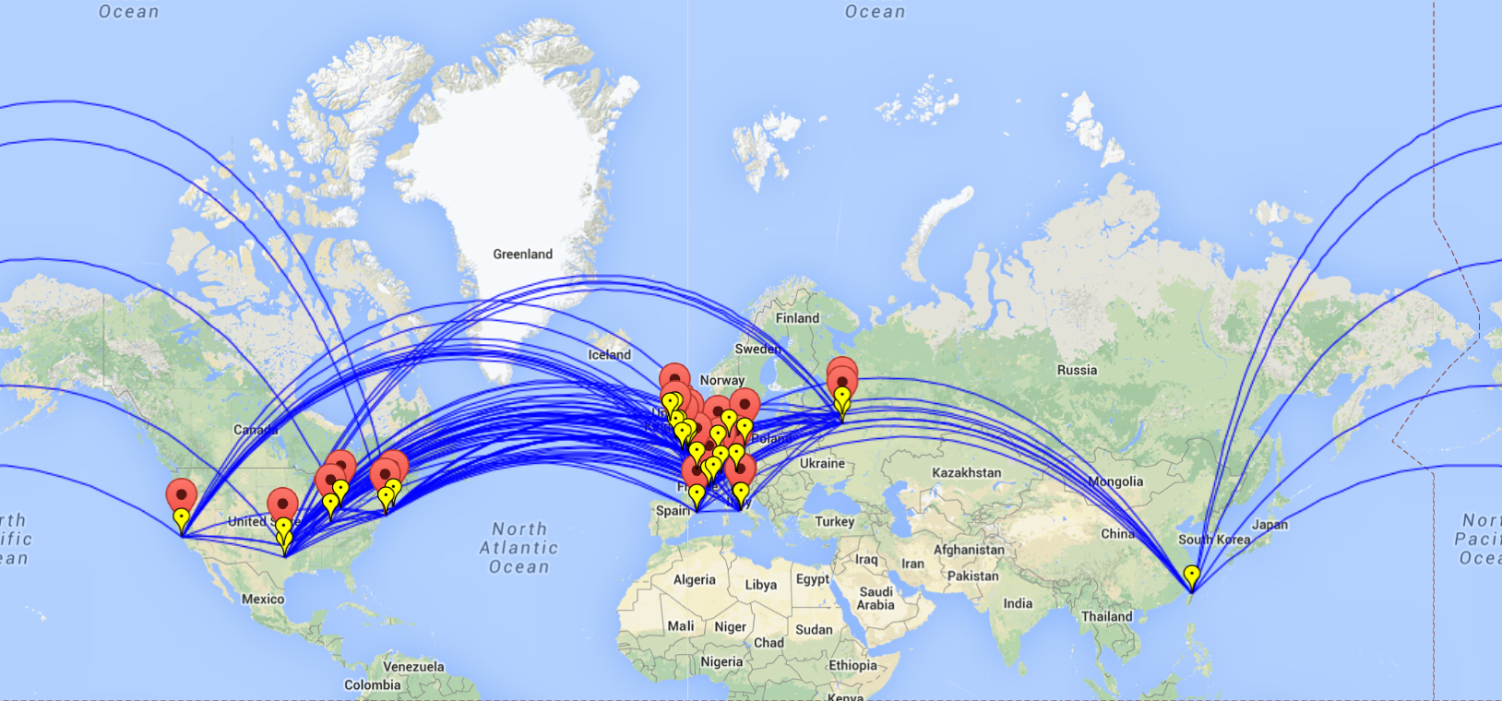
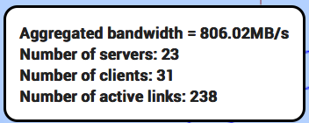
What is FAX?
FAX (Federated ATLAS Xrootd) is a way to directly access most of the ATLAS data from anywhere.
Read only
It relies on a gLFN (globalLogicalFileName)
Currently 42 sites are part of FAX (all the US, DE, UK, ES, CERN…)
> 98% of all data

Slide 9
But Not only that !
Large part of work is enabling ATLAS to use it effectively
Initial use cases
Failover from stage-in problems with local storage
Gain access to more CPUs using WAN direct read access
Allow brokering to Tier 2s with partial datasets
Opportunistic resources without local ATLAS storage
Use as caching mechanism at sites to reduce local data management tasks
Eliminate cataloging, consistency checking, deletion services
WAN data access group formed in ATLAS to determine use cases & requirements on infrastructure

Slide 10
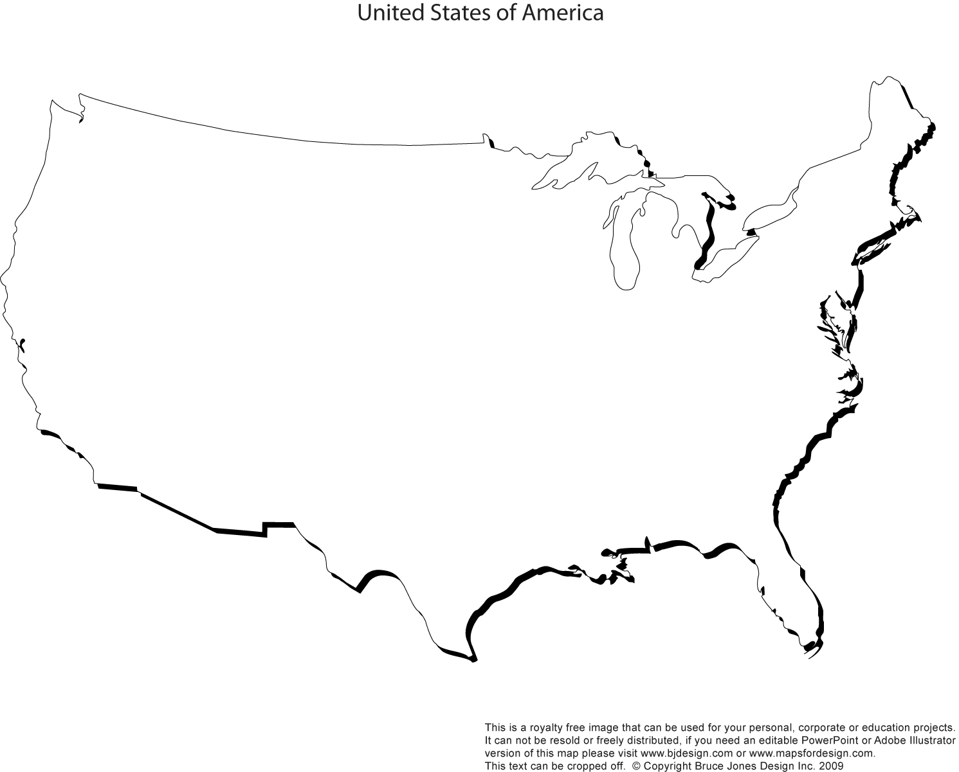


HOW it works
redirector
endpoint
bnl
ATLAS-XRD-ASIA
GLRD
ATLAS-XRD-EU
Data can be asked for from any endpoint and redirector
Data are transferred directly from server to user
Searching for the file is fast, delivering is more important
Ideally one should use the one with best connection
Usually that’s the closest one
XRD-CENTRAL
NET2
MWT2
AGLT2
SLAC
BNL
OCHEP
SWT2

Slide 11
Components / steps
gLFN – global Logical Filename
Protocol
Sites
Redirectors
Federation description
Monitoring
Integration
Applications
Documentation
Simplicity for user requires smart (complex) system.

Slide 12
Global Logical Filenames
In ATLAS data management based on DQ2
Files are organized in DataSets, DataSets in DataContainers, exist in one or more SpaceTokens at one or more StorageElements and are registered in DQ2
File catalog database LFC is an Oracle DB and contains mapping of logical file names to their physical path(s).
Each endpoint when asked for a file, queries LFC to find exact path of the file before delivering it or responding that file is not there.
Proved to be large complication: multiple LFCs, authentication issues, scaling, latencies
Now moving to new DDM system - RUCIO
Simple function will derive PFN from gLFN
Much faster, more reliable, easier to set up.

Slide 13






protocol
The XROOTD project aims at giving high performance, scalable, fault tolerant access to data repositories of many kinds.
Widely used in High Energy Physics
Supported by ROOT
XRootD clients: xrdcp and xrdfs
File path start with root://servername:[port]/…
Can serve from any posix storage, dCache xrootd plugin implements protocol

Slide 14
sites
ATLAS has 80+ computing sites organized in Tiers 0, 1, 2
Sites use all different kinds of storage technologies: xrootd, dCache, DPM, Lustre, storm, gpfs
And all of their different versions
We provide instructions for federating for all of them
https://twiki.cern.ch/twiki/bin/view/AtlasComputing/JoiningTheATLASFederation
To ease support we have experts for different technologies.
To ease communications we have contact persons per national cloud.

Slide 15
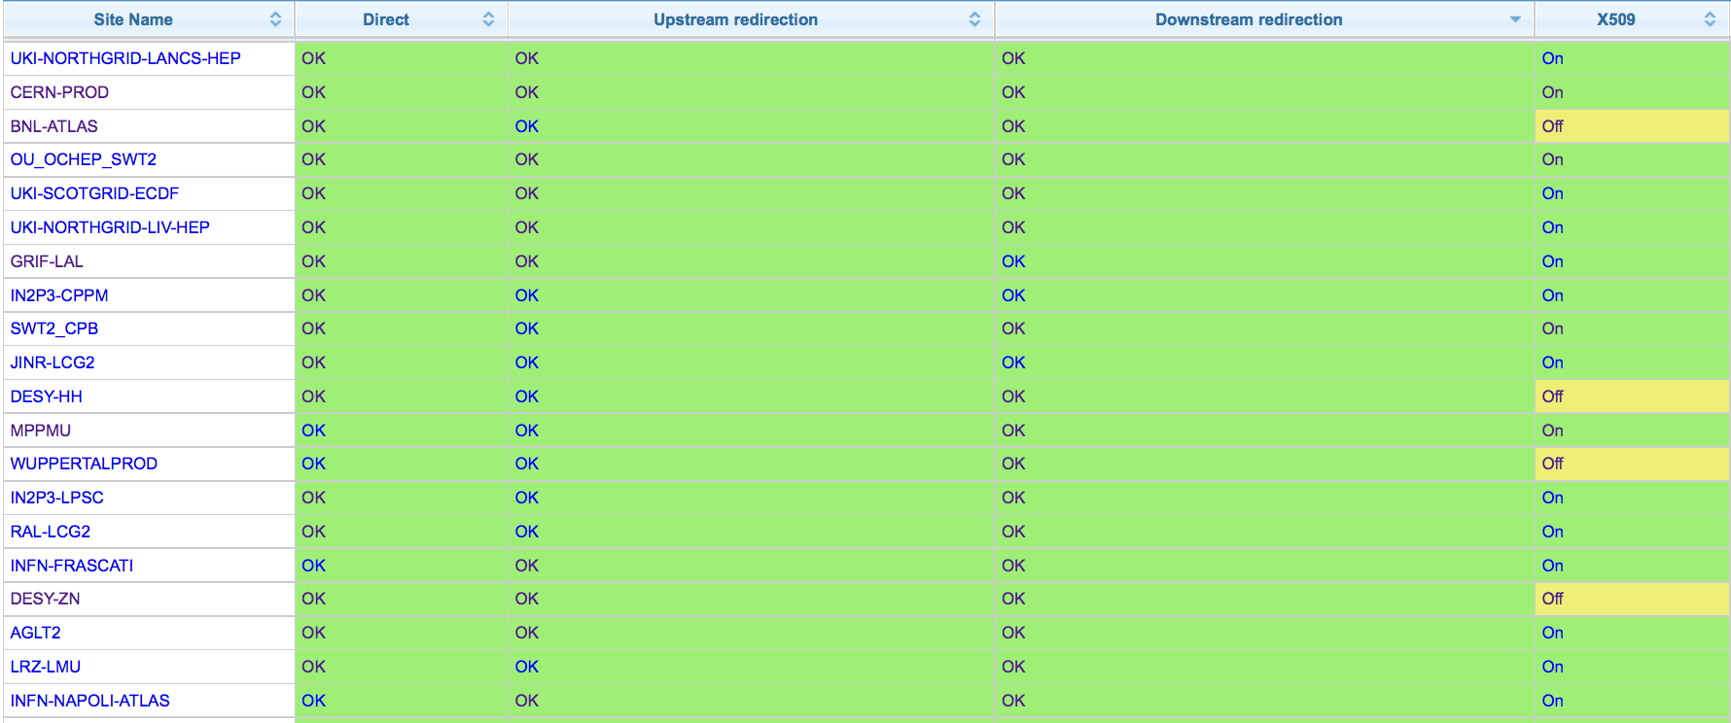
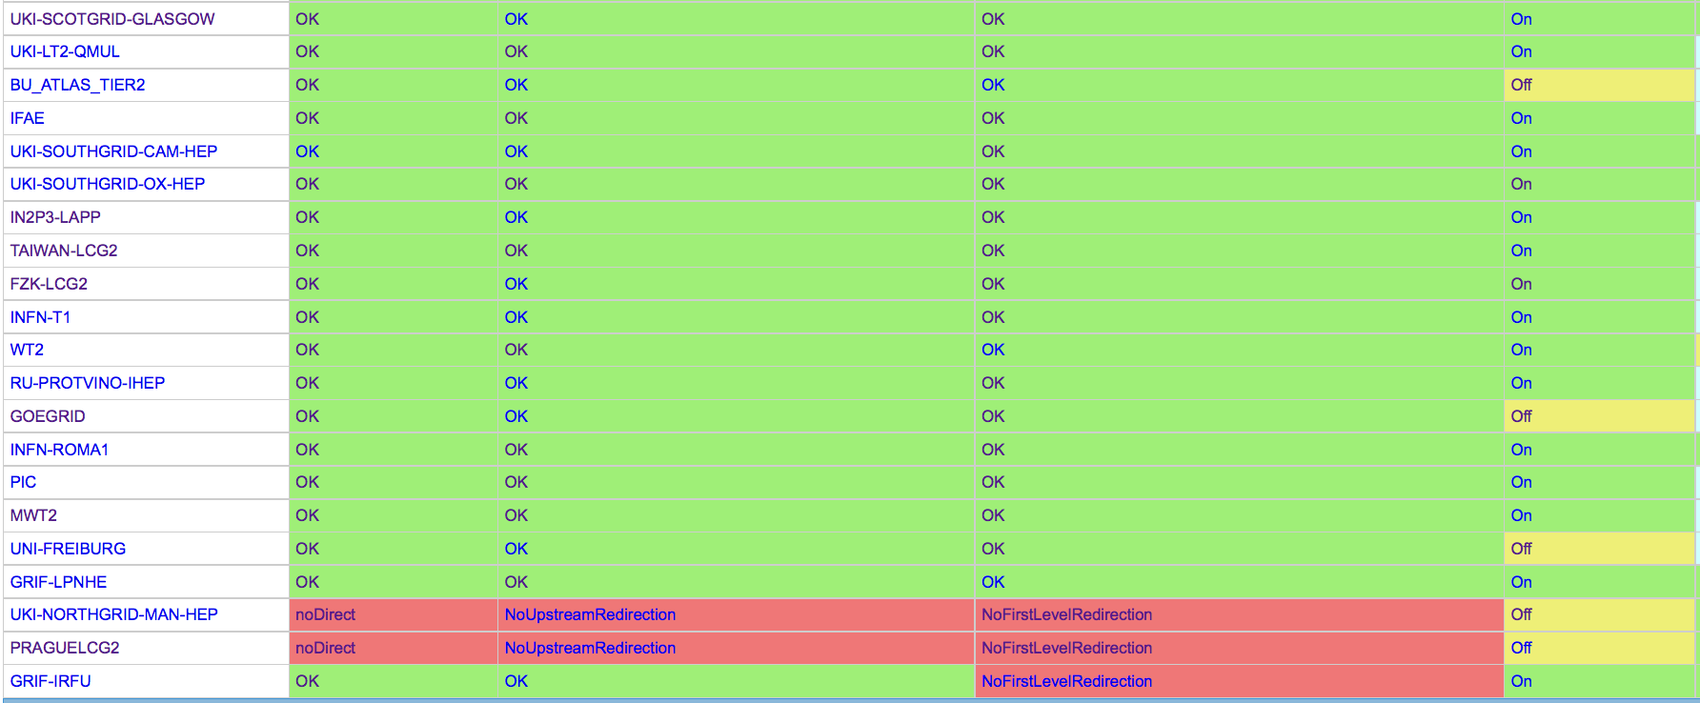
SITES
T0 | T1 | T2D
1/1 | 6/12 | 34/44
41 sites
72% done
All of USA, UK, DE, IT, RU, ES
Most of FR
Recently joined: Taiwan, PIC, IFAE
Next: AU, CA, NL

Slide 16
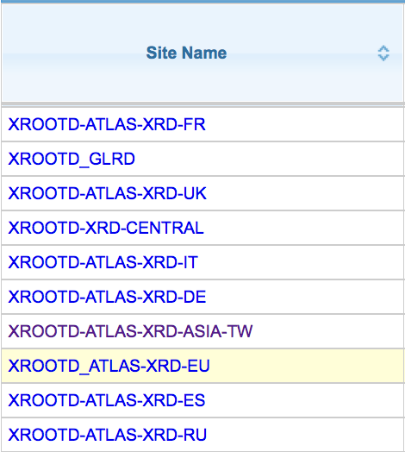
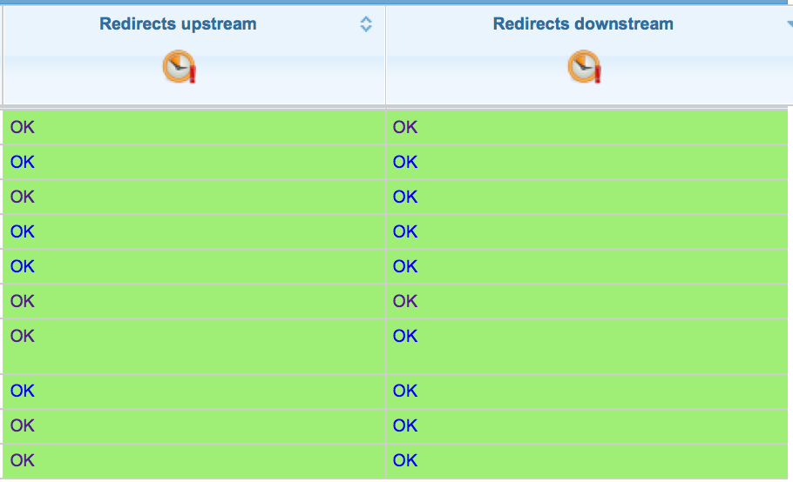
redirectors
Pair of xrootd/cmsd services
Lightweight, usually running on VM
GLRD
EU
ASIA
US central
UK
FR
DE
RU
ES
IT

Slide 17
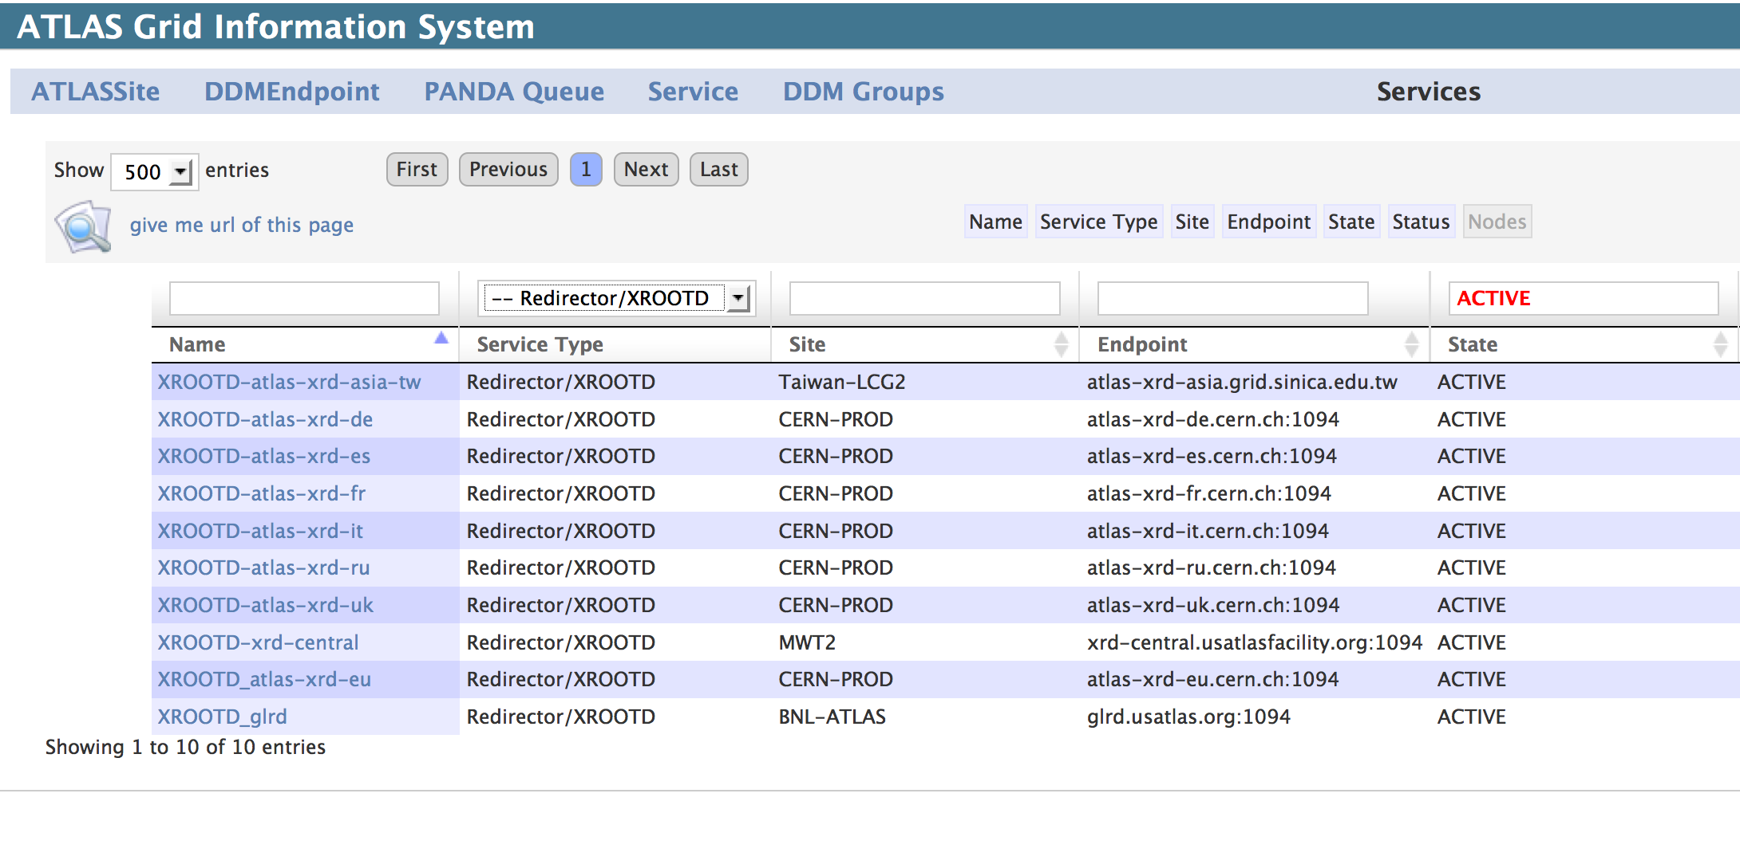
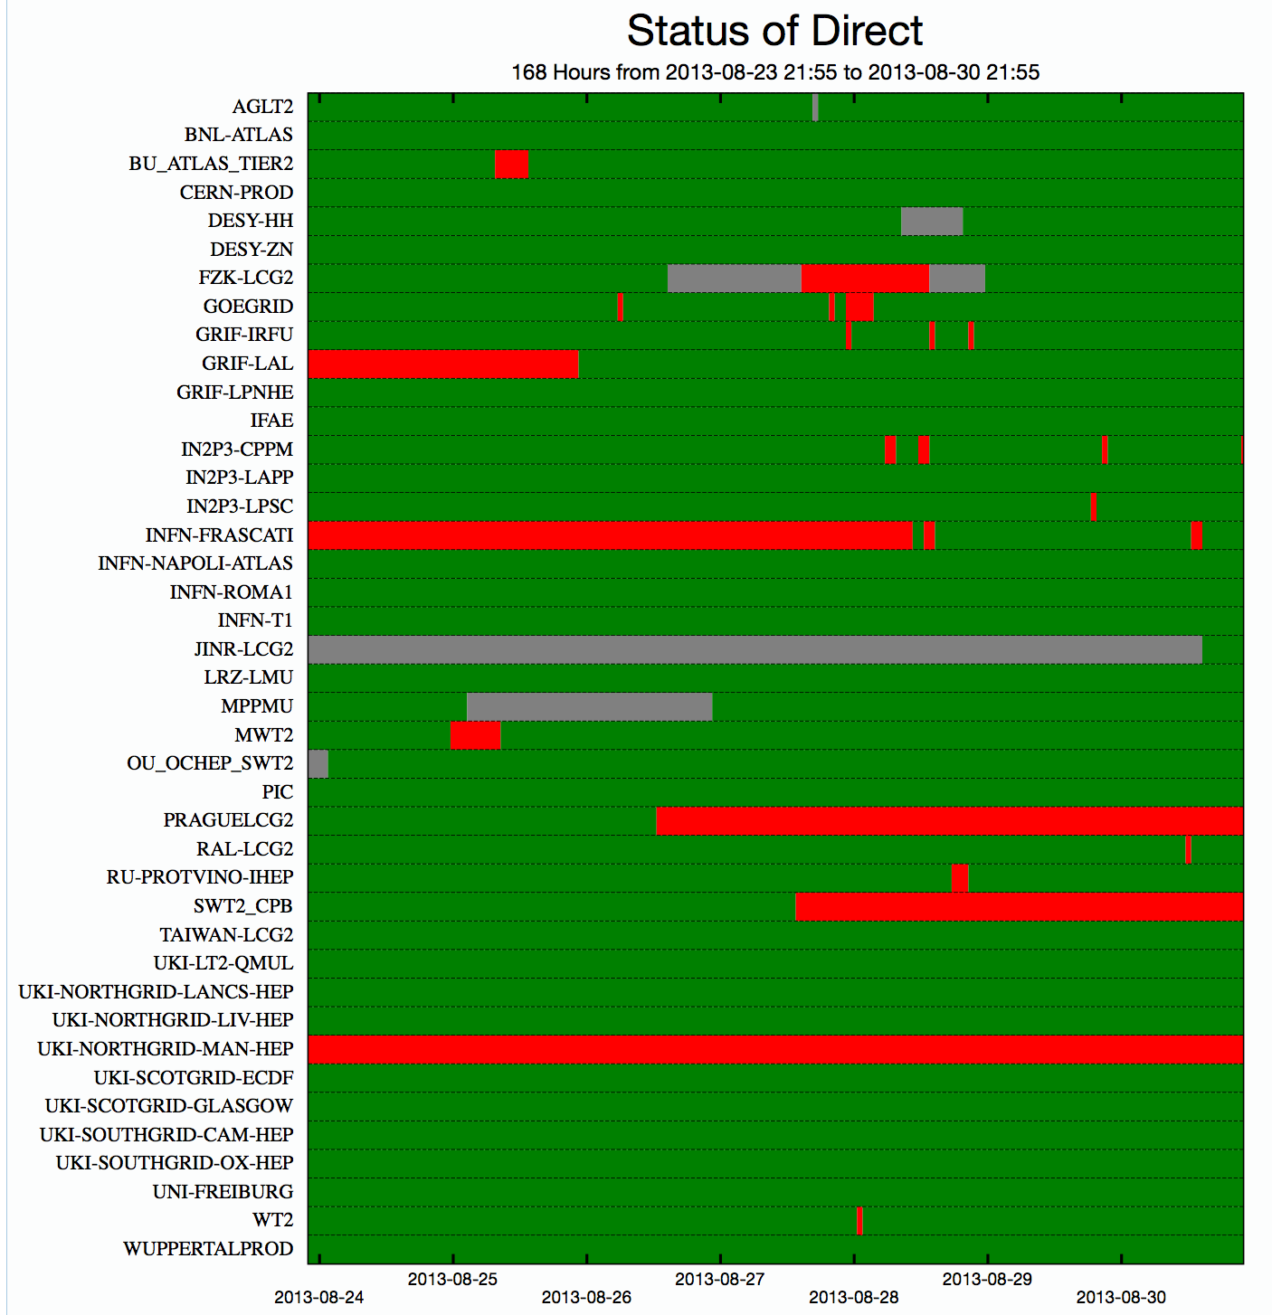
Describing federation
Both individual users and production/testing systems need to know access points, redirectors and their current status
FAX topology is described in ATLAS Grid Information System(AGIS)
Current status (and its history) are kept in Site Status Board (SSB)
Both AGIS and SSB expose information in JSON format
Missing test dataset
Missing test dataset
Missing test dataset
Missing test dataset
Missing test dataset

Slide 18
Monitoring
xRootD
dCache
DPM
posix
xRootD
Castor
dCache
xRootD
xroot4j
xRootD
xroot4j
Monitor
Monitor
UDP
Collector at CERN
Collector at SLAC
ActiveMQ
Consumers:
Popularity DB
SSB
Dashboard
Detailed stream
Summary
stream
MonaLisa

Slide 19
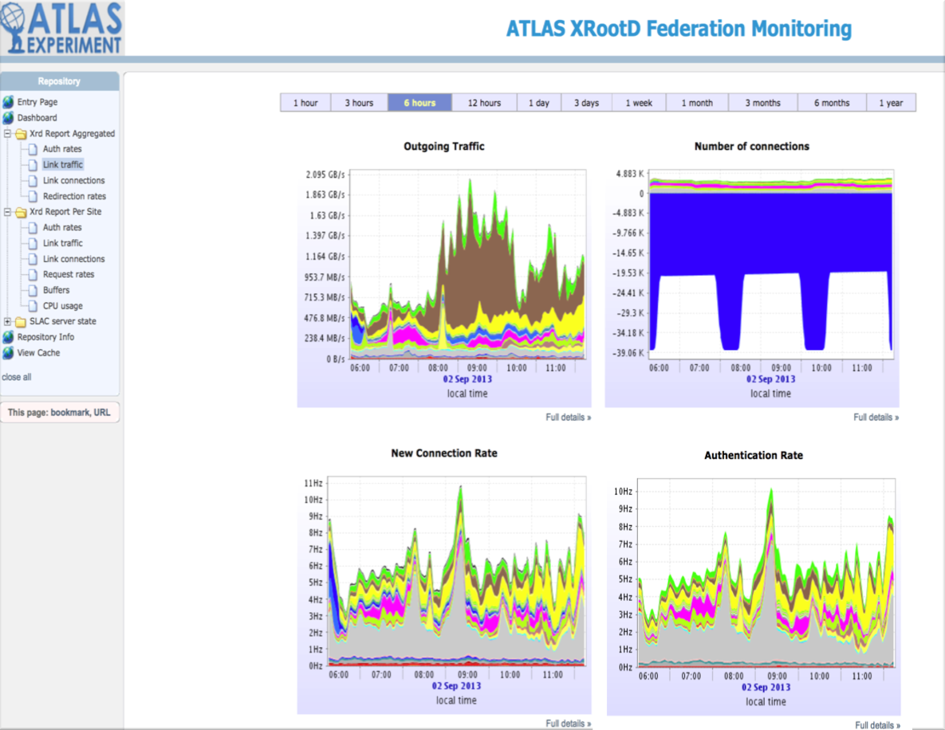
Summary Monitoring
Lightweight
XML
throughputs
connections
redirections
per site
per server
Results stored in postgresql
Shown in MonaLisa

Slide 20
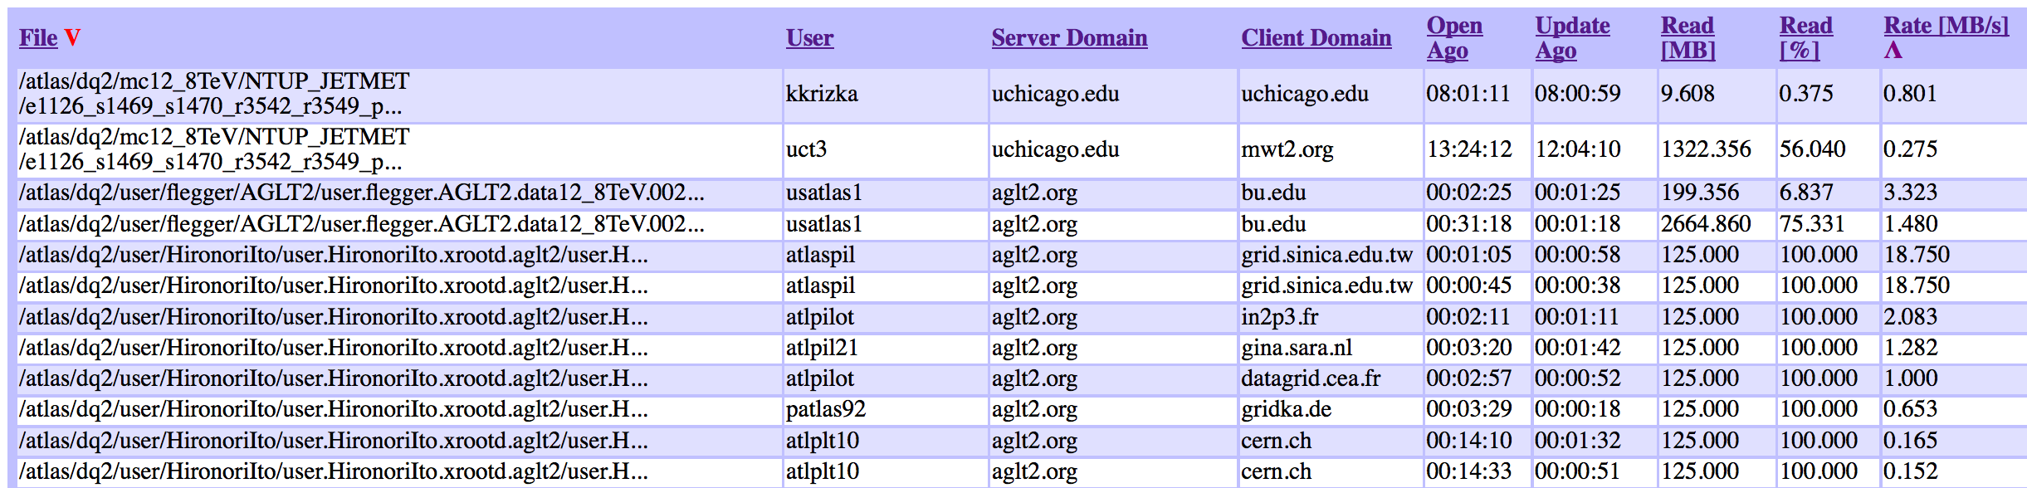
Detailed monitoring
Gives full information in real time ➔ actionable!
Several streams
File info
Path
Size
Open
Close
Reads/Vreads/Writes, …
User info
hostname
DN
pid
Server info
Application Info
Can see each currently open file
Usually >5k files
http://atl-prod05.slac.stanford.edu:4242/

Slide 21
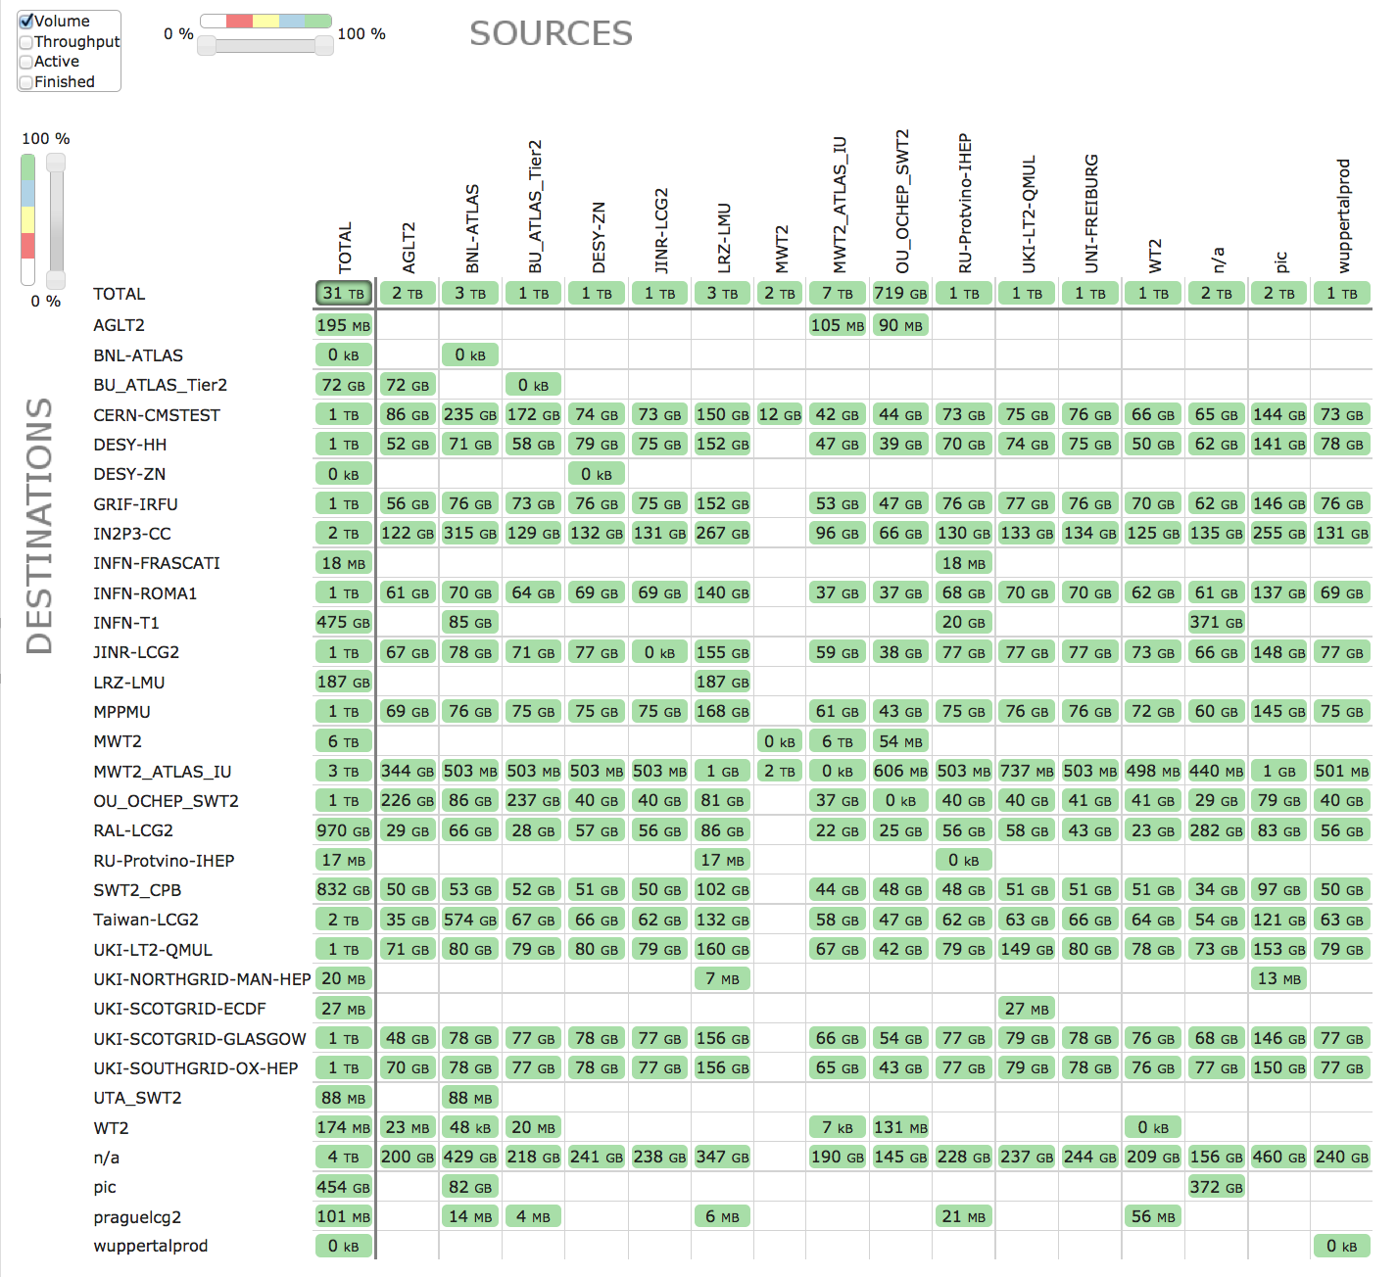
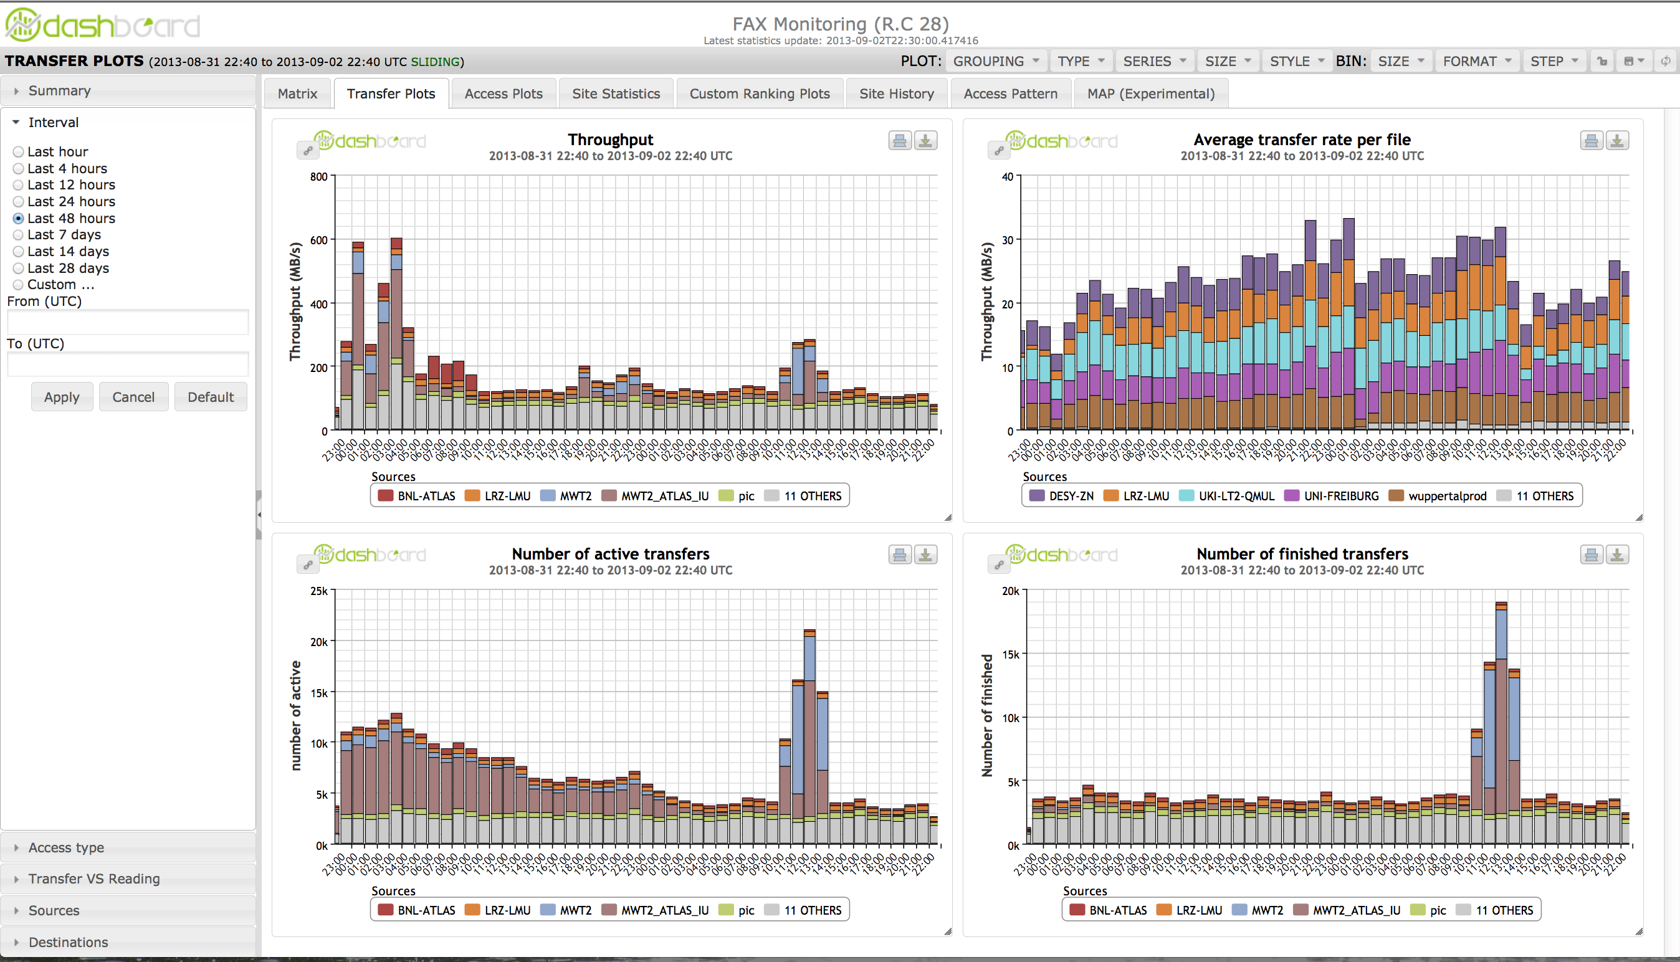
Detailed monitoring WLCG dashboard
Dashboard collects and keeps all the information
Will make it easy to slice & dice data
This is what shifters will look at when in production

Slide 22
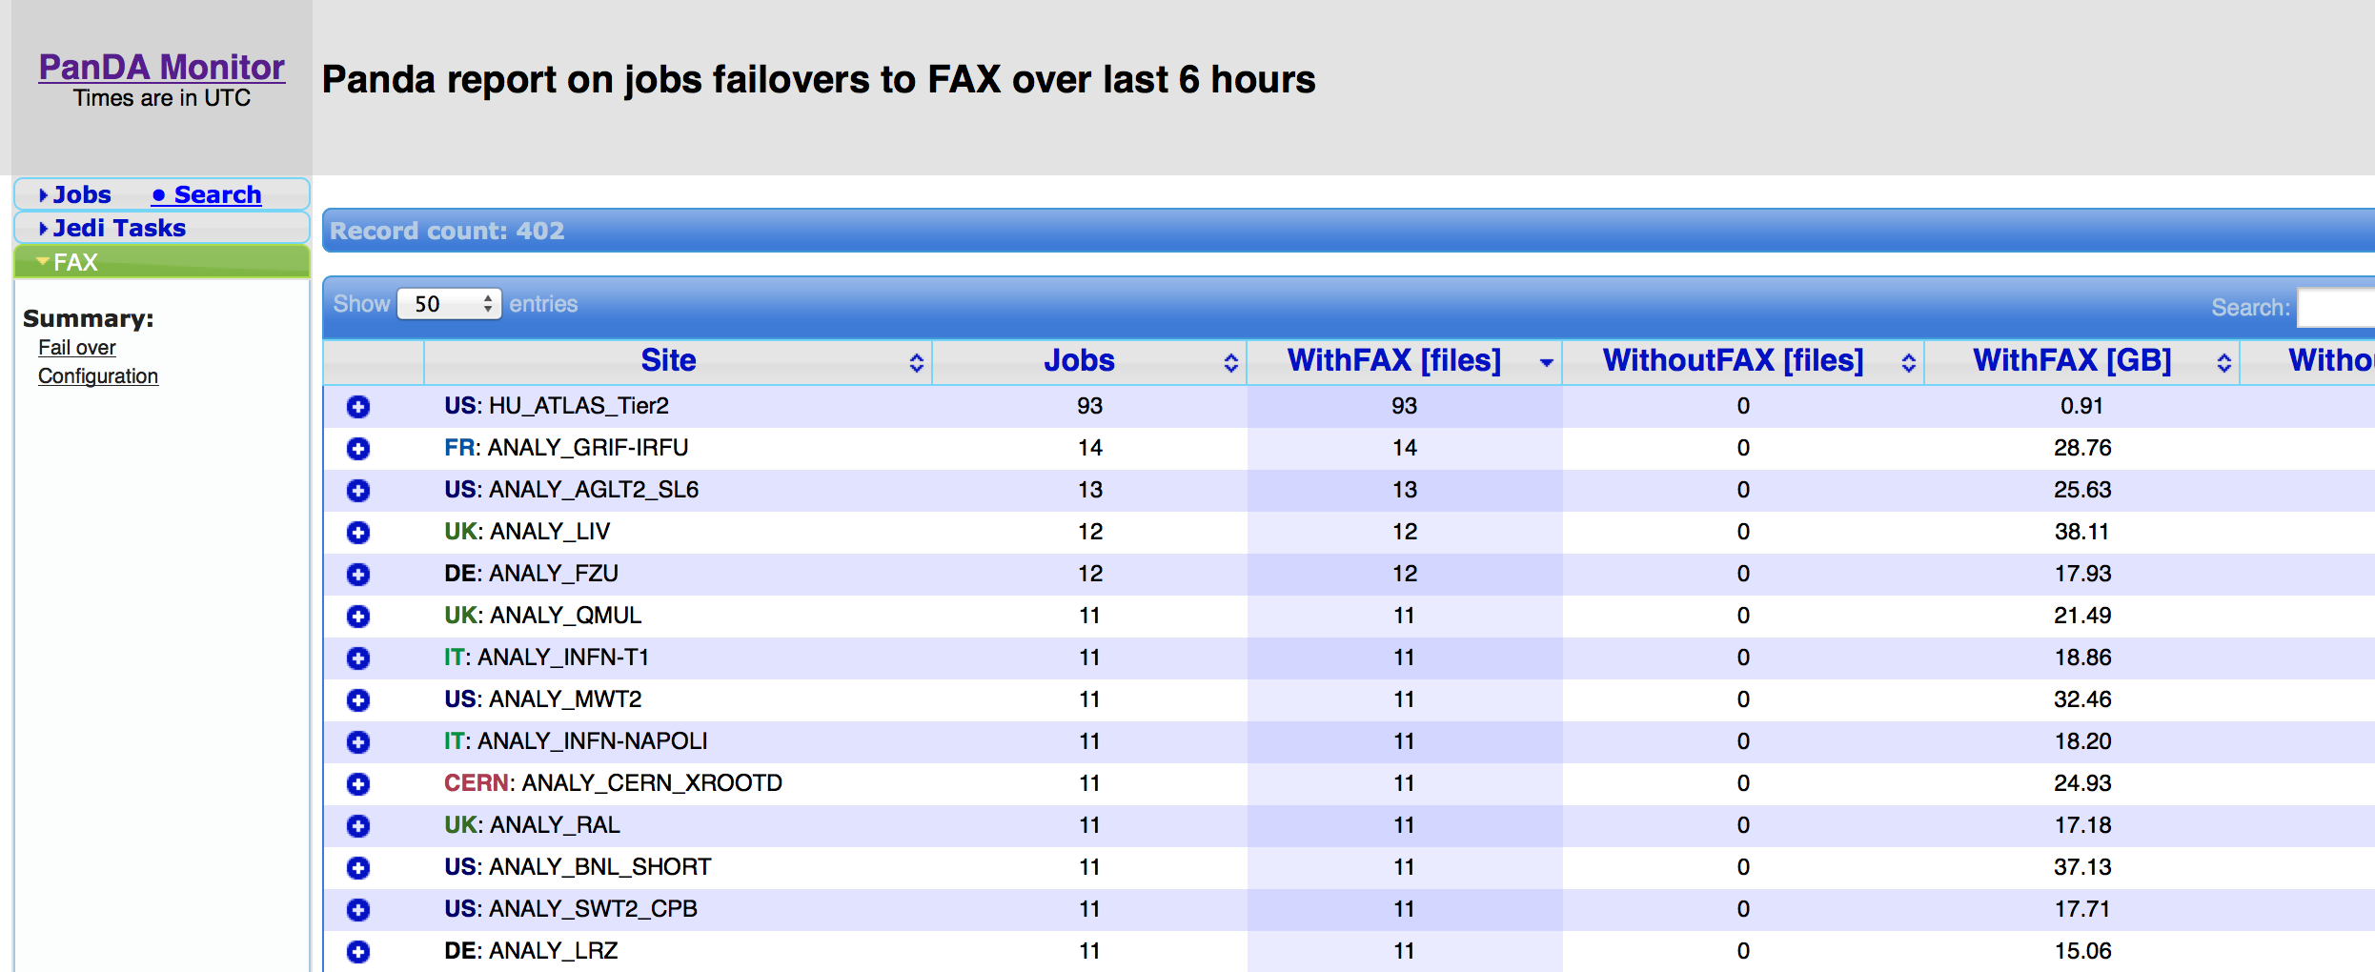
FAILOVER to FAX
PanDA (distributed production and analysis system for ATLAS) sends job only to sites having all the input data.
In case that an input file can not be obtained after 2 tries, the file will be obtained through FAX in case it exists anywhere else.
There are in average 2.8 copies of files from recent reprocessing in FAX.
Ultimate success would be for a site to for example update it’s storage without first draining it of jobs.

Slide 23
Brokering to FAX
One can broker jobs to sites that don’t have all or part of input data and use FAX to read them directly. Beneficial in cases where:
Site have very often full queues as some specific data exist only there
Site has free CPUs, good connectivity but not enough storage/data
One can use external sources of CPU cycles (OSG, Amazon/Google cloud based queues,…)
For this approach to be efficient, system has to “know” expected available bandwidth between a queue and all of the FAX endpoints.
We continuously measure this data and store it in Cost Matrix.
We expect brokering to fAX to be functional in a few months.

Slide 24





COST matrix
Measures transfer rates (memory-to-memory) between 42 ANALY queues and each FAX endpoint
Jobs submitted by HammerCloud
Jobs send results to ActiveMQ, consumed by dedicated machine stored in SSB view “FAX cost matrix”
FAX
PanDA
FTS
SSB
Sonar
view
SSB
FAX cost matrix
Rest
HammerCloud

Slide 25
applications
With a dedicate CPUs or a lot of CPUs available on demand, we can provide “map-reduce-like” web applications for some simpler tasks requiring access to most of the data.
Ongoing developments:
EventPickingService
Requires access to potentially all data
Not much bandwidth
Not much CPU
SkimSlimService
To help users go from multi terabyte data to multi gigabyte scale data
Very frequent grid task
A lot of optimizations possible
Need to find balance between making it general and useful enough while limiting resource usage

Slide 26
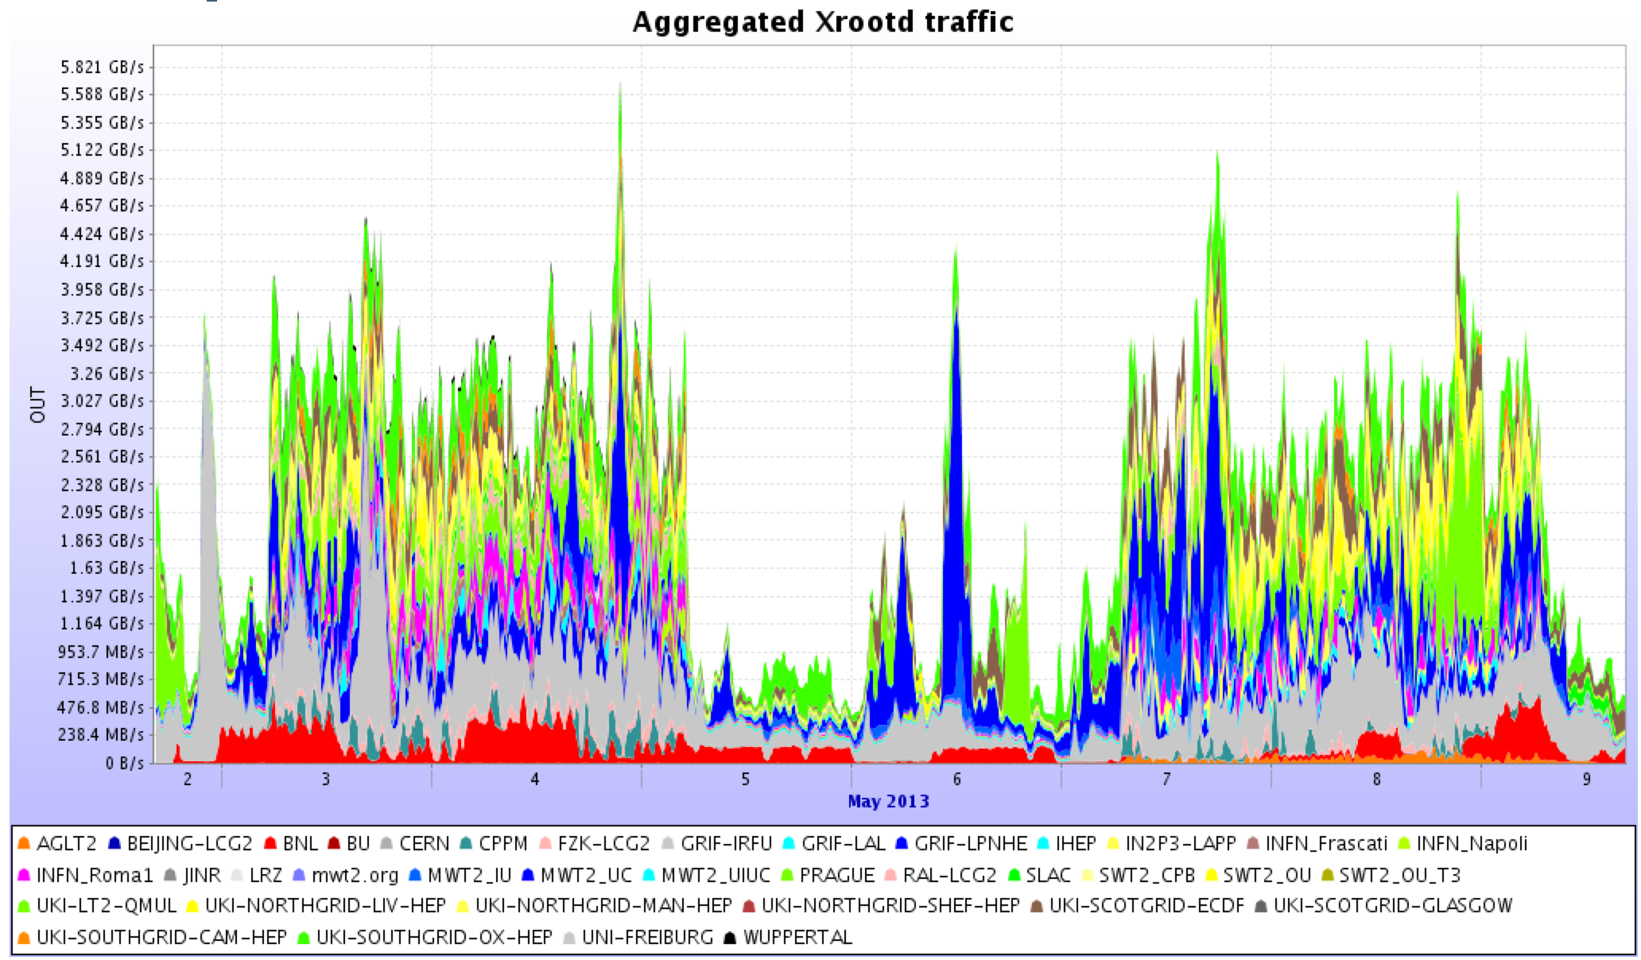
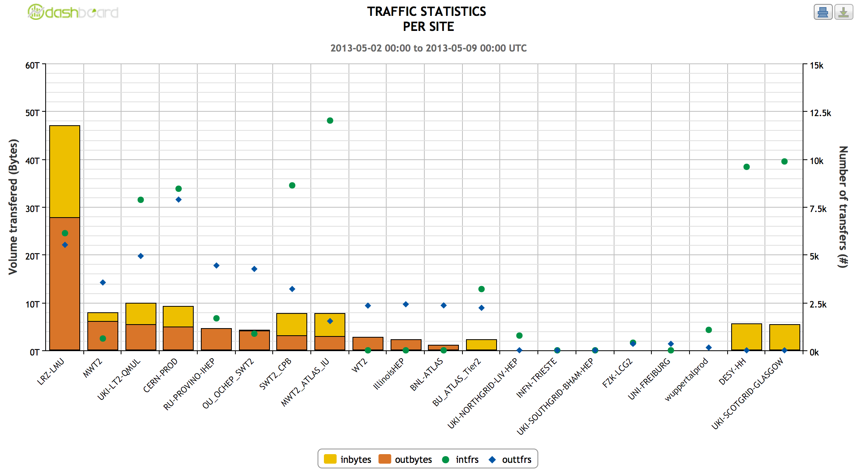
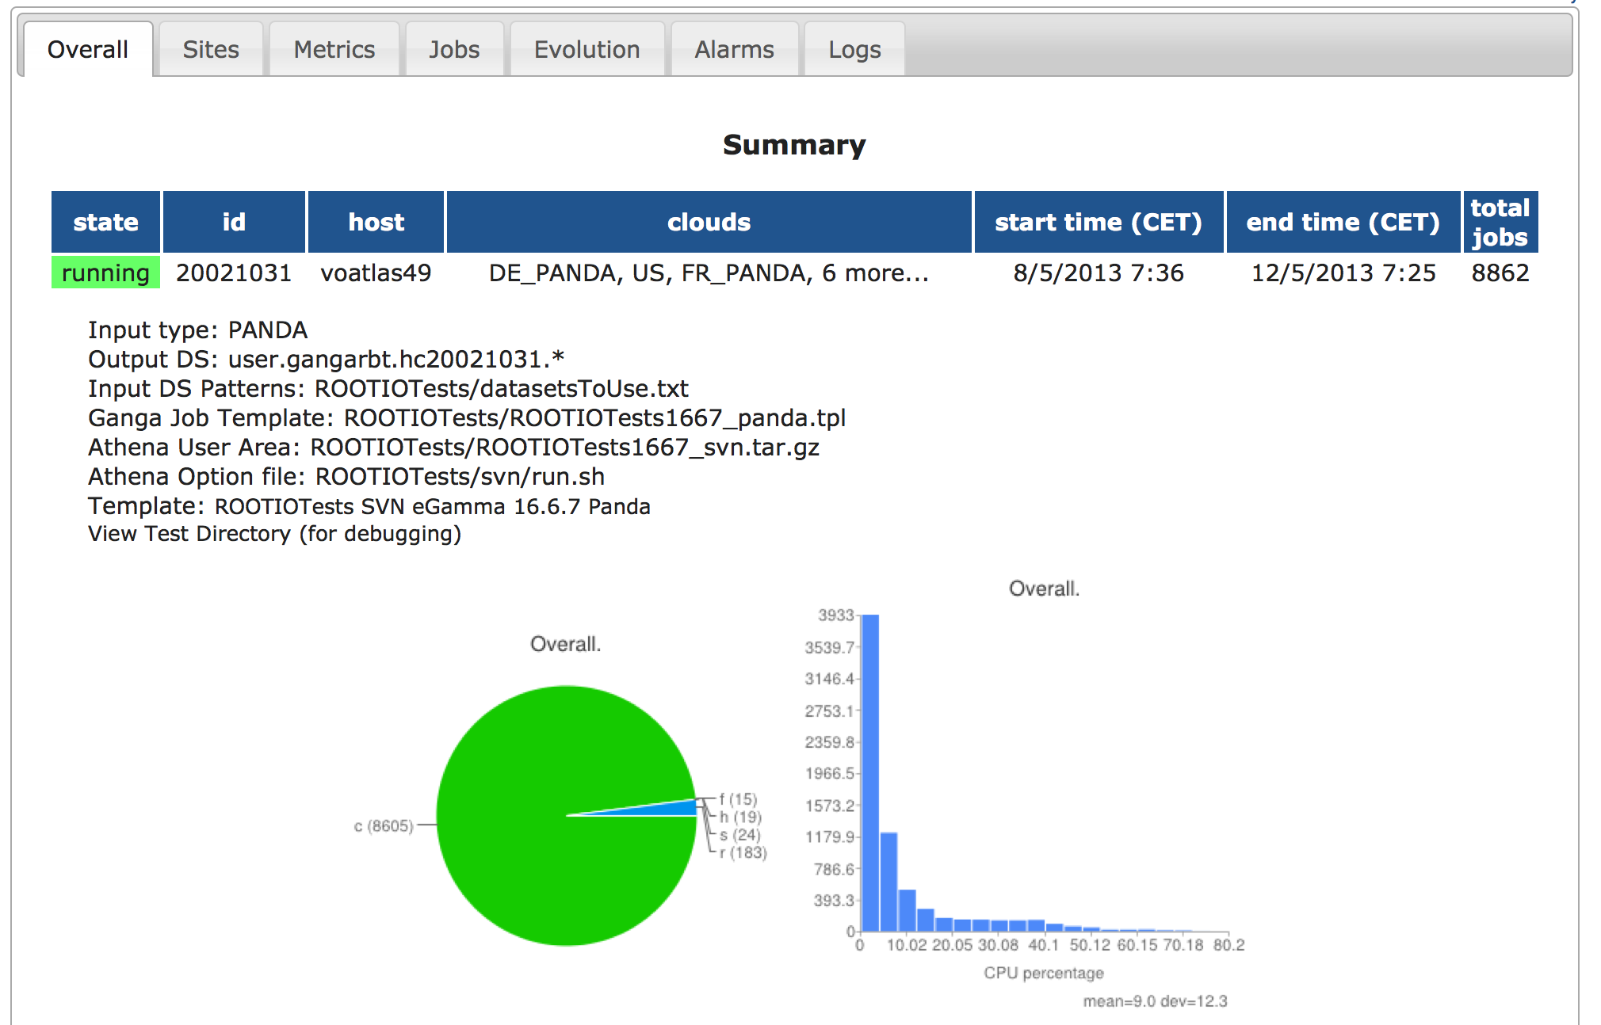
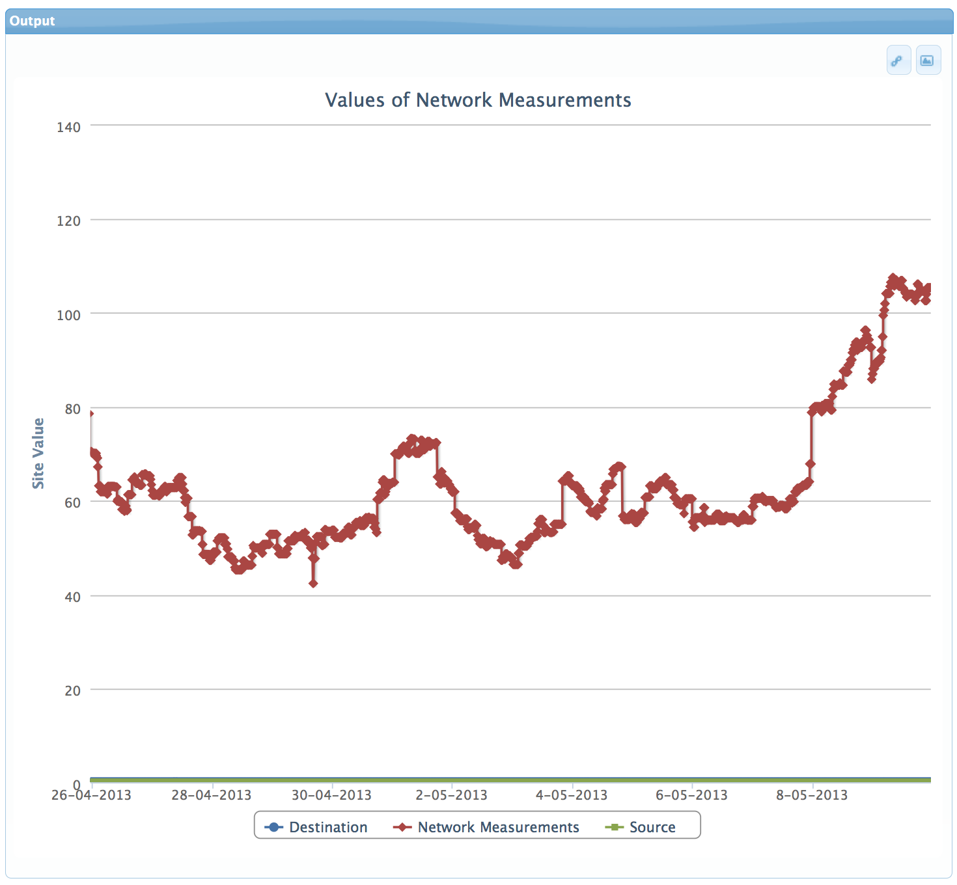
Performance
Metrics
Data Coverage
Number of users
Percentage of successful jobs
Total amount of data delivered
Bandwidth usage
Source
Ganglia plots
MonaLisa
FAX Dashboard
HC tests
CostMatrix tests
Special tests using dedicated resources
better than 98%, more than 2 replicas
mostly UofC, Prague users
Latest HC tests >99%
~ 2PB/week
Notes:
There are many different performance metrics one can define for system with so many components. Here’s the list of the most important ones.
Very good coverage, and is getting better
We could do better job in getting users
Very small number of errors (these are all the errors in HC jobs not only FAX related ones)
While we’ve seen peaks of 6-7 GB/s, that’s mostly driven by our tests and UofC and Prague users. Still small compared to DDM transfers.
At our bi-weekly meetings we look at all of these but here will concentrate only on the last one of metrics : bandwidth available
There are different ways to get this information, all with it’s goods and bads.

Slide 27
Future
Increase coverage, add redundancy, increase total bandwidth
Enlargement
Increase performance, reduce bandwidth needs
Caching
Cost matrix – smart FAX
Smart network - Bandwidth requests, QOS assurance
Improve adoption rate
Presenting, teaching, preaching
New services
Improve satisfaction
FAX tuning
Application tuning
New services

Slide 28
Conclusions
Federation is functional
First use cases implemented
Usage is increasing
Powerful tool that has to be used wisely.
Took more effort than initially expected
A lot of people (in different time zones) involved
Had to develop things multiple times for different storage technologies
Had to integrate it in our frameworks
Establishing effective monitoring as complex as establishing federation

Slide 29
Thank you! Questions?

